Slide 1
Finding Area of Rectangle
Student’s Name

Slide 2
Introduction
The lesson will focus on finding area of a rectangle.
The education level is mathematics for third graders in the state of California.
The lesson will take 1 ½ to 2 hours.

Slide 3
California State Standards- CA CSS Math
a. Use concepts of area and relate area to multiplication and to addition. (CACSS: 3.MD)
Recognize area as an attribute of plane figures and apply concepts of area measurement.5 (CACSS: 3.MD.5)
Find area of rectangles with whole number side lengths using a variety of methods 6 (CACSS: 3.MD.7a)

Slide 4
California State Standards- CA CSS Math
iii. Relate area to the operations of multiplication and addition and recognize area as additive.7 (CASSS: 3.MD.7)
b. Describe perimeter as an attribute of plane figures and distinguish between linear and area measures. (CACSS: 3.MD)
c. Solve real world and mathematical problems involving perimeters of polygons. (CACSS: 3.MD.8)

Slide 5
Prior Knowledge
Operations and Algebraic thinking
Recall that multiplication and division are inverse and can be remodeled.
Solve problems involving multiplication and division.
Interpreting products of whole numbers.
Interpret quotients of whole numbers.
Use multiplication and division within 100 to solve word problems.
Determine the unknown numbers in multiplication and division scenarios.

Slide 6
Lesson Development
Key Terms
Area
Square
Materials
Multiplication worksheet
1 inch square unit graph paper worksheet.
Use manipulative
Pencil

Slide 7
Lesson Development
Lesson Objectives
Students will be able to multiply square units to find the area of a rectangle.
Lesson Procedure
Have a warm up multiplication exercise on a worksheet ( not more than 3 minutes).

Slide 8
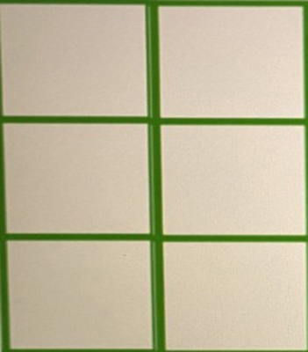

Lesson Introduction
Use six square tiles during introduction.
Demonstrate each unit of 1 square unit.
Calculate the number of I inch square units in a rectangle.

Slide 9
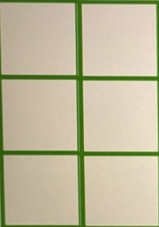
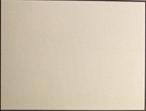
Lesson Introduction
Calculate the number of 1 inch square units in a rectangle.
Rectangle with six square tiles
The area is 1 × 6 = 6 square units
Interpret this as the area of the rectangle.

Slide 10
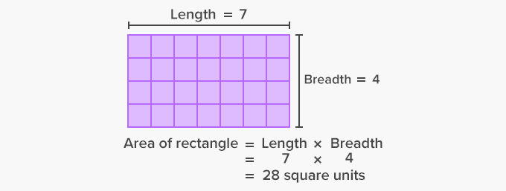
Demonstration
Sample Calculation of area. Team up students to carry some area calculation by counting and multiplication.
This demonstrates area of a rectangle by calculation and multiplication.

Slide 11
Lesson Conclusion Assessment
Ask each student to independently model a rectangle of area 16 square units.
Have students suggest the method they find most suitable for finding area.
Then collect students’ work and review it to find their understanding of the concept, and find out students who need additional support.

Slide 12
References
Finding Area. (2015). Retrieved from https://www.education.com/lesson- plan/finding-area/
Mathematics academic standards: Third grade. (2013). https://www.cde.ca.gov/be/st/ss/documents/ccssmathstandardaug2013.pdf

